Slide 1
Better programming for fun & profit
Or how to avoid ‘code grief’

Slide 2
Measure twice, cut once
Don’t rush to code. Plan & describe what your program will do and what it needs (Specification)
Can just write a few paragraphs of text
Or draw a flowchart (see right) e.g. https://www.draw.io/
Try to anticipate user responses (PEBKAC – Problem Exists Between Keyboard And Chair) and handle resulting errors
When writing anything beyond trivial programs try a bottom up approach i.e. write and test components before including them in your main program.
Learn to use pip and you will then be able to use a vast library of python modules – this will save you writing code that re-invents the wheel.

Slide 3
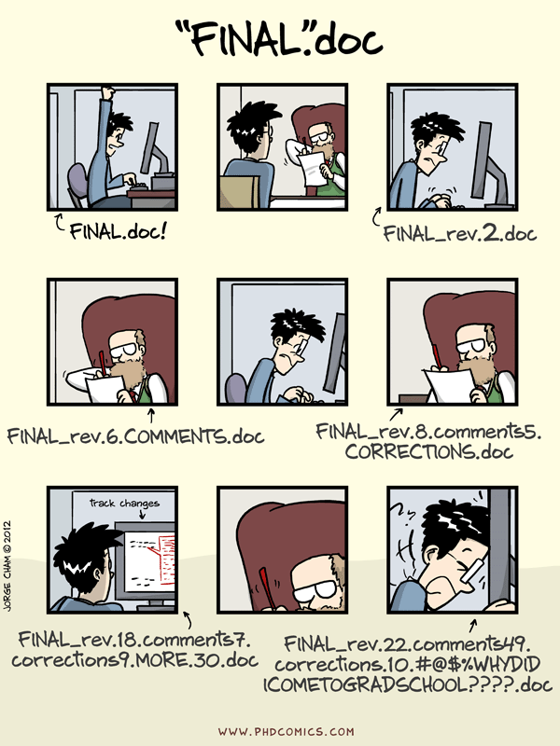
Use versioning tools
These are tools that handle revisions of material (not just programs)
Subversion
Git/GitHub/Gitlab You effectively create save points and can ‘roll back’ to an earlier version. Useful when by adding new code you accidentally break your program!
Can handle several authors and track who made what changes
Repositories (repos) are good way of making your software available on the WWW
http://blogs.nature.com/naturejobs/2018/06/11/git-the-reproducibility-tool-scientists-love-to-hate/

Slide 4
Environments that help you code
IDEs e.g. IDLE Integrated Development Environments combine editing, debugging (fixing programs – discussed later), help files and features like code completion
Jupyter notebooks Different strengths to IDEs
Code can be deployed to the web for people to download and use.
Can be annotated and added to in order to document the code and your thoughts.
These are useful e.g. if you publish a workflow as supplementary material in a paper
Can access Command-line shell programs from within notebook e.g. samtools and include their output in your notebook.

